Slide 1
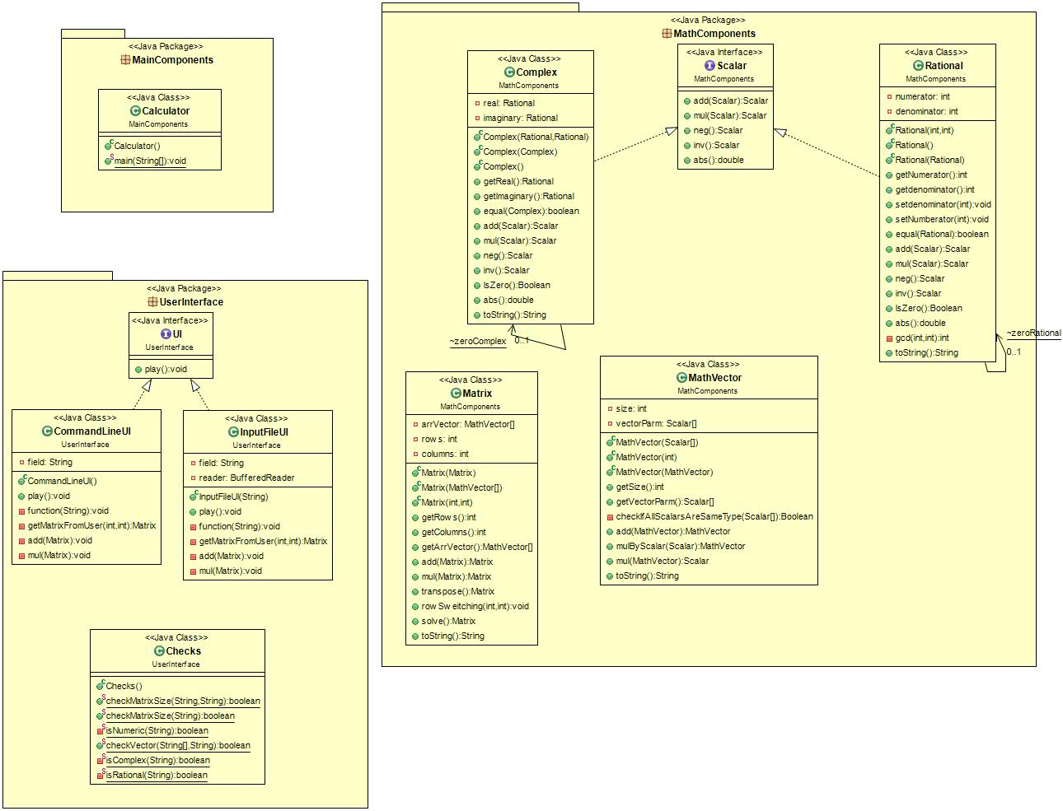
0..1, client
1..*, server
Run the UI>
0..1, client
2, server
0..1, server
0..1, client
Creates and use matrix functions >
0..1, client
0..*, server
1..*, server
0..1, client
0..1, client
0..1, client
Use static checks >
0..1, server

